Slide 1
Mobile Application Development
Lecture 3

Slide 2
Introduction to Components
Components are like building blocks of a program. Think of components as blocks. You join many blocks together to build a house. Sometimes you use same blocks/components in different areas of the house.
<div> </div> tag in HTML provides a logical block. Components can be like that.
Components are just a controller for a user interface.

Slide 3
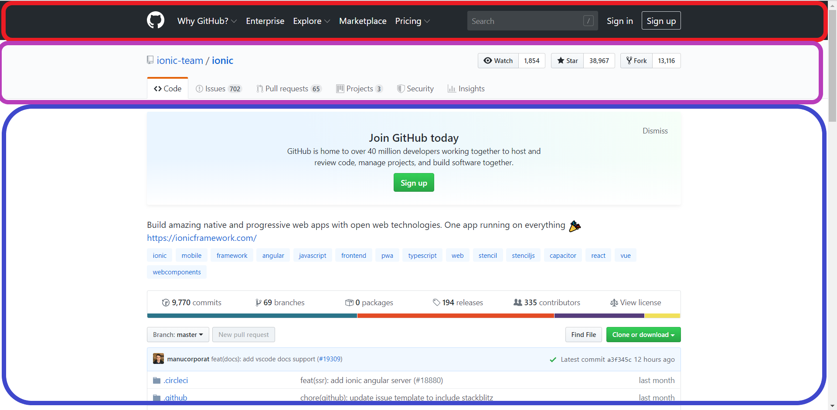
Navbar component
Repository Detail component
Repository detail navbar component

Slide 4
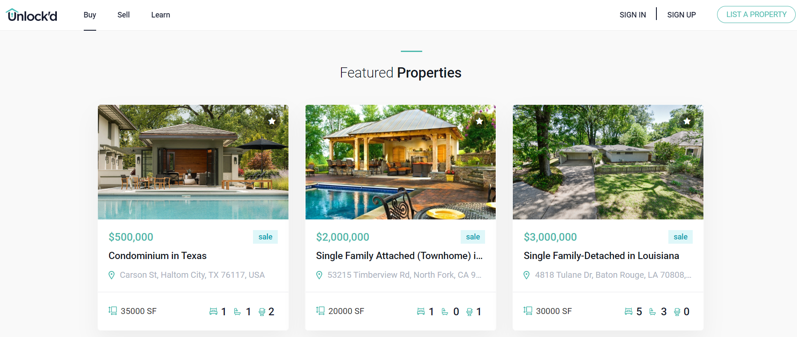
Navbar
List Items

Slide 5
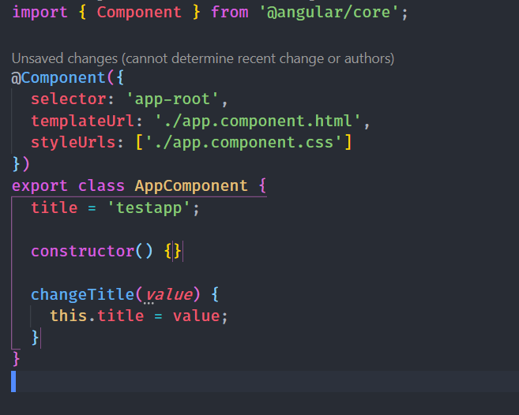
Example of a Component
A Component in Angular has its own css file (optional), html file and a .ts (typescript file).
@Component is a TypeScript Decorator. It provides
meta data. E.g Selector, html file, css file.
if it was a Directive or Pipe, it would be @Pipe, @Directive

Slide 6
“Don’t wish it were easier; wish you were better.” ~ Jim Rohn

Slide 7
Angular Modules
Modules is a mechanism to group components, directives, pipes and services that are related, in such a way that can be combined.
A Module is a collection of different components (usually with a similar functionality)
By Default, we have 1 App module. We can create modules ourselves depending on our needs.

Slide 8
Directives
Directive is a component without its html or css.
Directives are very powerful as they help you change functionality of the DOM/View depending on your requirements.
Angular provides few built-in directives (*ngFor, *ngIf). However, we can also create directives ourself.

Slide 9
Type of Directives
There are three main types of directives in Angular:
Component - directive with a template. (yes components are a directive)
Attribute directives - directives that change the behavior of a component or element but don't affect the template. E.g ngClass, ngStyle
Structural directives - directives that change the behavior of a component or element by affecting how the template is rendered . E.g *ngIf, *ngFor

Slide 10
Pipes
Pipes provides a new way of filtering data.
There are many built-in pipes like currency, date etc. However, just like Directives, we can create them according to our requirements.
Pipes only filter data but don’t actually change the value.

Slide 11
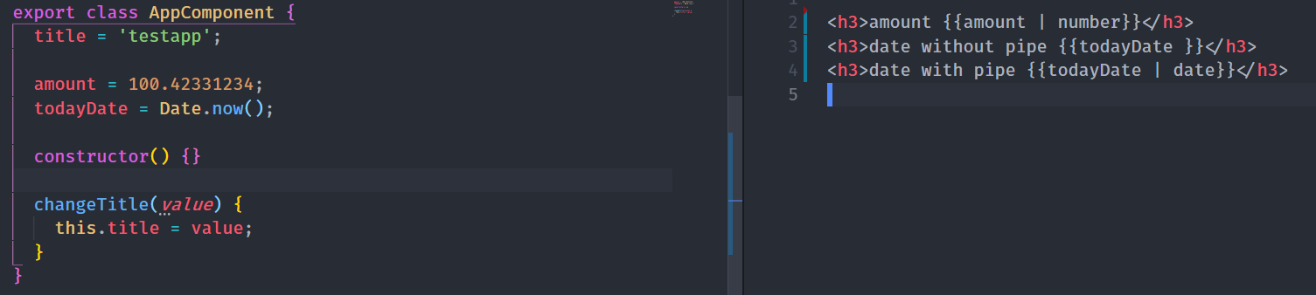
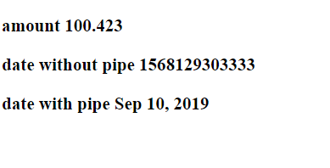
Result in Browser

Slide 12
Template Syntax in Angular
A template helps us to render HTML with some dynamic parts depending on our data.
{{ }} for interpolation.
[] for property binding.
() for event binding.
# for variable declaration.
* for structural directives.
Interpolation allows you to incorporate calculated strings into the text between HTML element tags and within attribute assignments. E.g {{ amount }} or {{ 2+4 }}. It can also include a JS expression
Notes:
Dont worry about memorizing these. You’ll understand them better once we use them later on.

